Slide 1
Lesson 6: Command-based (continued)
Fe Maidens Programming 2017 - 2018
Spotlight: Drivetrain (Autonomous & Teleoperated) and Gears
Notes:
Stress that they need to be good at this because they will be writing the drive code for build season

Slide 2
DriveAuton code from last meeting
(review + new concepts)
import edu.wpi.first.wpilibj.command.Command;
import org.usfirst.frc.team2265.robot.subsystems.Drivetrain;
package org.usfirst.frc.team2265.robot.commands;
import org.usfirst.frc.team2265.robot.Robot;
public class DriveAuton extends Command {
private double left, right;
public DriveAuton (double l, double r) {
left = l;
right = r;
}
protected void initialize() {
}
protected void execute() {
Robot.drivetrain.drive(left, right);
}
protected boolean isFinished() {
return false;
}
protected void end() {
Robot.drivetrain.drive(0,0);
}
protected void interrupted(){
}
}
Can someone explain each part of the code (excluding these imports)?
These methods are given to us by FRC. “protected” means that these methods are accessible to this class, the package, (commands) and other subclasses.

Slide 3
Drivetrain subsystem
public class Drivetrain extends Subsystem {
public static AnalogGyro gyro = new AnalogGyro(RobotMap.gyroPort); public static CANTalon frontLeft = new CANTalon(RobotMap.frontLeftPort); public static CANTalon rearLeft = new CANTalon(RobotMap.rearLeftPort); public static CANTalon frontRight = new CANTalon(RobotMap.frontRightPort); public static CANTalon rearRight = new CANTalon(RobotMap.rearRightPort); public static RobotDrive tankDrive = new RobotDrive(frontLeft, rearLeft, frontRight, rearRight); public static Encoder encoderLeft = new Encoder(RobotMap.encPort1, RobotMap.encPort2, true, Encoder.EncodingType.k1X); public static Encoder encoderRight = new Encoder(RobotMap.encPort3, RobotMap.encPort4, false, Encoder.EncodingType.k1X); public static double constant = 8.6; public Drivetrain() { encoderLeft.setMaxPeriod(2); encoderRight.setMaxPeriod(2); } // auton public void drive(double l, double r) { frontRight.set(-r); rearRight.set(-r); frontLeft.set(l); rearLeft.set(l); }
}
package org.usfirst.frc.team2265.robot.subsystems;
import edu.wpi.first.wpilibj.command.Subsystem;
import org.usfirst.frc.team2265.robot.commands.AutoAlign;
import org.usfirst.frc.team2265.robot.commands.DriveTeleop;
import org.usfirst.frc.team2265.robot.OI;
import org.usfirst.frc.team2265.robot.Robot;
import org.usfirst.frc.team2265.robot.RobotMap;
import com.ctre.CANTalon;
import edu.wpi.first.wpilibj.RobotDrive;
import edu.wpi.first.wpilibj.Joystick;
import edu.wpi.first.wpilibj.AnalogGyro;
import edu.wpi.first.wpilibj.Encoder;

Slide 4
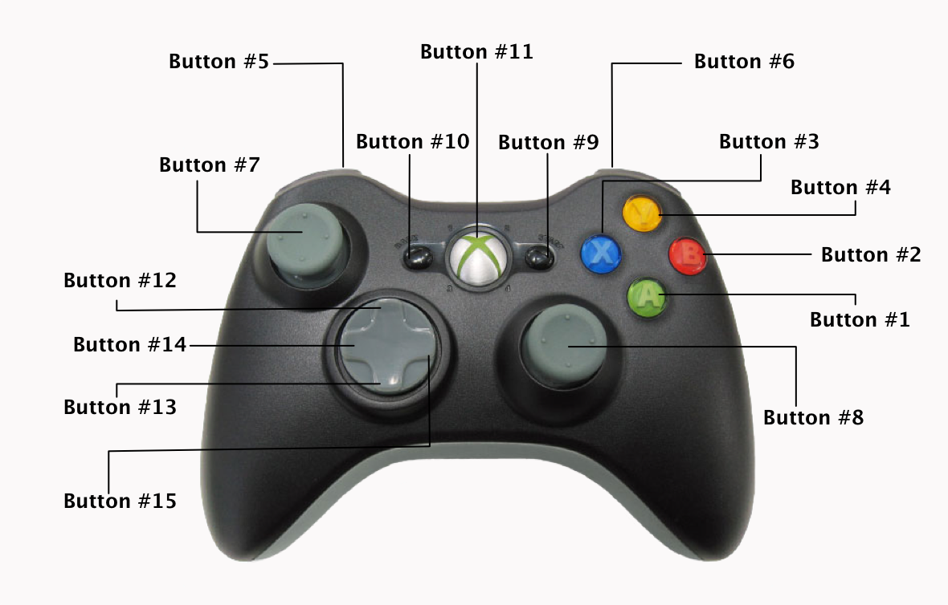
DriveTeleop Command
package org.usfirst.frc.team2265.robot.commands; import edu.wpi.first.wpilibj.command.Command; import org.usfirst.frc.team2265.robot.Robot; public class DriveTeleop extends Command { public DriveTeleop() { requires(Robot.drivetrain); } protected void initialize() { } protected void execute() { if (Robot.slow == false) { Robot.drivetrain.drive(); } else if (Robot.slow == true) { Robot.drivetrain.driveSlow(); } } protected boolean isFinished() { return false; /* Make this return true when this Command no longer needs to run execute() */ } // Called once after isFinished returns true protected void end() { } protected void interrupted() { } }

Slide 5
Drivetrain Subsystem
public class Drivetrain extends Subsystem {
public static AnalogGyro gyro = new AnalogGyro(RobotMap.gyroPort); public static CANTalon frontLeft = new CANTalon(RobotMap.frontLeftPort); public static CANTalon rearLeft = new CANTalon(RobotMap.rearLeftPort); public static CANTalon frontRight = new CANTalon(RobotMap.frontRightPort); public static CANTalon rearRight = new CANTalon(RobotMap.rearRightPort); public static Joystick atkjoy = new Joystick(RobotMap.atkJoyPort); public static RobotDrive tankDrive = new RobotDrive(frontLeft, rearLeft, frontRight, rearRight); public static Encoder encoderLeft = new Encoder(RobotMap.encPort1, RobotMap.encPort2, true, Encoder.EncodingType.k1X); public static Encoder encoderRight = new Encoder(RobotMap.encPort3, RobotMap.encPort4, false, Encoder.EncodingType.k1X);
public Drivetrain() { encoderLeft.setMaxPeriod(2); encoderRight.setMaxPeriod(2); }
public void drive() {
double leftVal = atkjoy.getRawAxis(5);
double rightVal = atkjoy.getRawAxis(1);
tankDrive.tankDrive(leftVal, rightVal);
}
}

Slide 6
Video of the robot scoring gears!!

Slide 7
Now let’s see it in a command group!
package org.usfirst.frc.team2265.robot.commands; import org.usfirst.frc.team2265.robot.Robot; import edu.wpi.first.wpilibj.command.CommandGroup; public class CenterAuto extends CommandGroup { public static double d; public CenterAuto() { addSequential(new DriveDistance(65.0, 1.0)); addSequential(new ShiftChute(false)); addSequential(new DriveDistanceBack(-12.0, -0.4)); } }
//This is when the robot does scores from the center to the peg.

